Slide 1

Social Media Listening for CGM Efficacy, expectation and barriers to use
Abishaik Mohan | Diksha Chand | Muhammad Asad Shoaib
Spring ‘23

Slide 2
Agenda
Background & Approach
Problem at Hand
Project Goal
Beneficiary from Solution
Exploratory Data Analysis
Data pre-processing
Data Modelling
Results & Evaluation
Recommendations

Slide 3
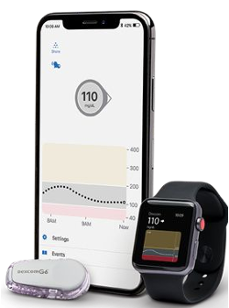
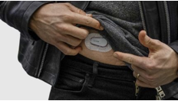


Background & Approach
Diabetes
Body can’t use or produce insulin
No cure but can be managed
Continuous Glucose Monitoring (CGM)
Solution for real-time tracking of glucose levels
Dexcom and FreeStyle Libre are two popular products
Social Media Analysis for Product Improvements
Twitter, blogs, forums can be analyzed to gather sentiments and understand customer expectations

Slide 4
Problem at Hand
Diabetes -> CGMs -> Improved health
Efficacy
Barriers to Usage
Source:
Battelino T, Conget I, Olsen B, et al. The use and efficacy of CGM in monitoring in type 1 diabetes treated with insulin pump therapy: a randomized controlled trial. Diabetologia. 2012;55:3155-3162
Lanning M, Tanenbaum M, Barriers to Continuous Glucose Monitoring in People With Type 1 Diabetes: Clinician Perspectives: https://www.ncbi.nlm.nih.gov/pmc/articles/PMC7666603/
Notes:
Diabetes – leading cause of death
CGMs according to the study can help improve health outcomes by providing a real-time feedback. Yet, the uptake has not been as much precedented.
So before one makes the jump to better health outcomes using CGMs, we wanted to understand that, in light of user experience, how effective have they been with current users and what inhibits users from using frequently

Slide 5
Project Goal
Understand
Customer expectations
User behavior
Pain points
Perceived Benefits
Recommendations
Overall CGM patient expectations
Product-specific features
Notes:
So to be more specific, we wanted to understand

Slide 6
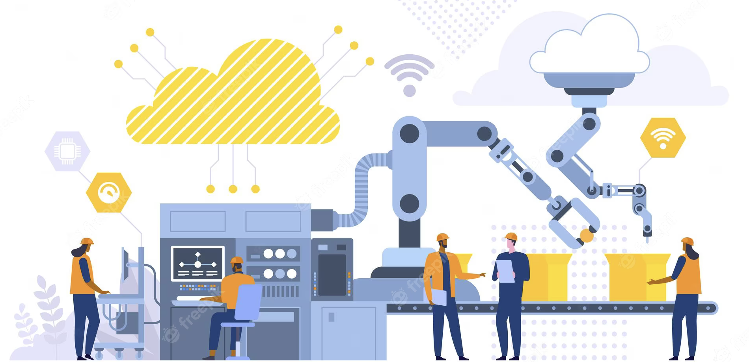


Beneficiaries
1. Manufacturers of CGM
2. Policy Makers
3. Patients
Notes:
Propose solutions for whom, one may ask?
Biggest end-consumer: Manufacturer

Slide 7
Agenda
Background & Approach
Problem at Hand
Project Goal
Beneficiary from Solution
Exploratory Data Analysis
Data pre-processing
Data Modelling
Results & Evaluation
Recommendations
Notes:
Lets dive into what we did about this

Slide 8
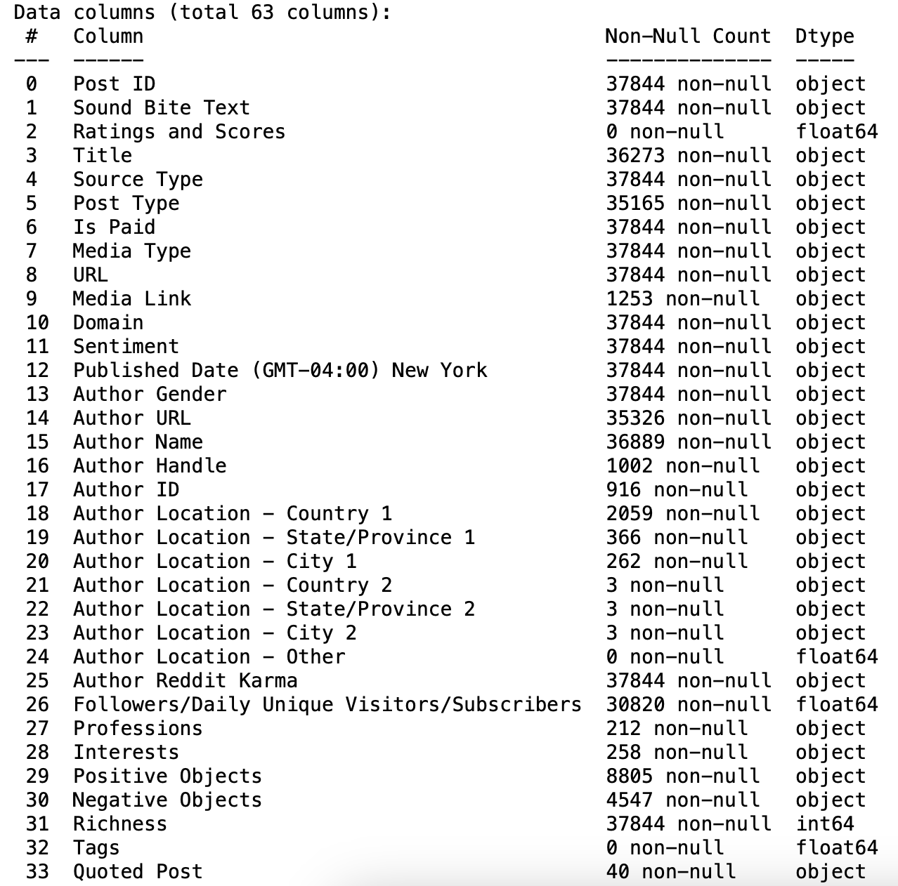
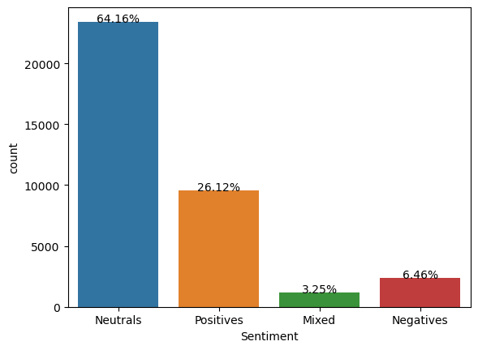
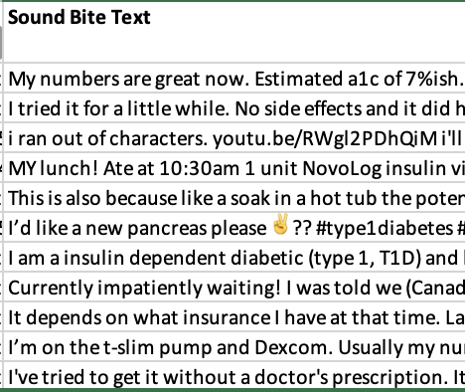
Exploratory Data Analysis
Dataset Metadata
Sentiment Distribution
Exploring Column of Interest
Notes:
Explored the data, foudn a lot columns having nulls
explored the distributions of variables

Slide 9
Agenda
Background & Approach
Problem at Hand
Project Goal
Beneficiary from Solution
Exploratory Data Analysis
Data pre-processing
Data Modelling
Results & Evaluation
Recommendations
Notes:
pulled up our sleeves and decided to get our hands dirty

Slide 10
Data Pre-processing
General
Model
Filtering data containing relevant terms ('cgm’,expect’,’benefit’ etc.)
Dropping null columns to make data handling manageable
Removing stop words
Removing URLs
Removing mentions and usernames
Removing single characters
Removing numerical values
Removing frequently used words
Tokenizing the Words
POS Tagging
Lemmatizing
Extracting noun phrases
Creating dictionary, corpus
Used text + title for original posts as title also adds context to the post
Notes:
pulled up our sleeves and decided to get our hands dirty

Slide 11
Agenda
Background & Approach
Problem at Hand
Project Goal
Beneficiary from Solution
Exploratory Data Analysis
Data pre-processing
Data Modelling
Results & Evaluation
Recommendations
Notes:
This is where things get interesting

Slide 12
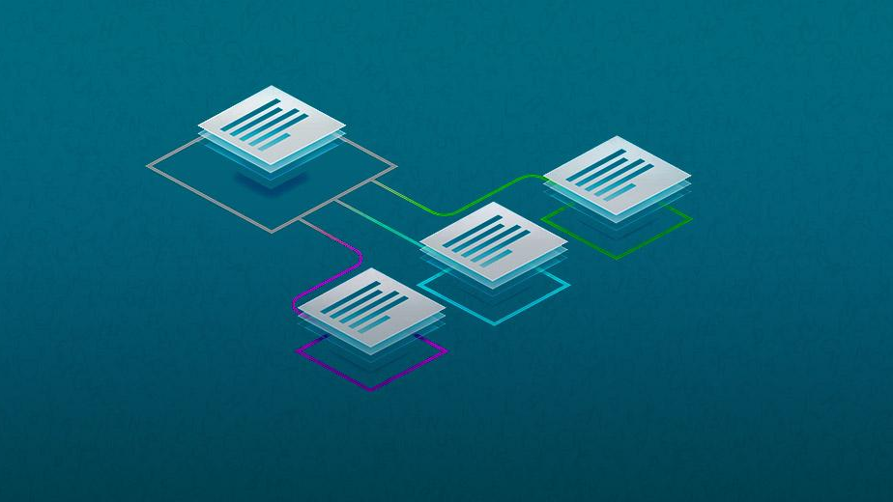
Topic Modeling
Latent Dirichlet Algorithm + Bigrams/Trigrams
Notes:
Model takes the input documents and divides into topic clusters based on relevancy and frequency of the words

Slide 13
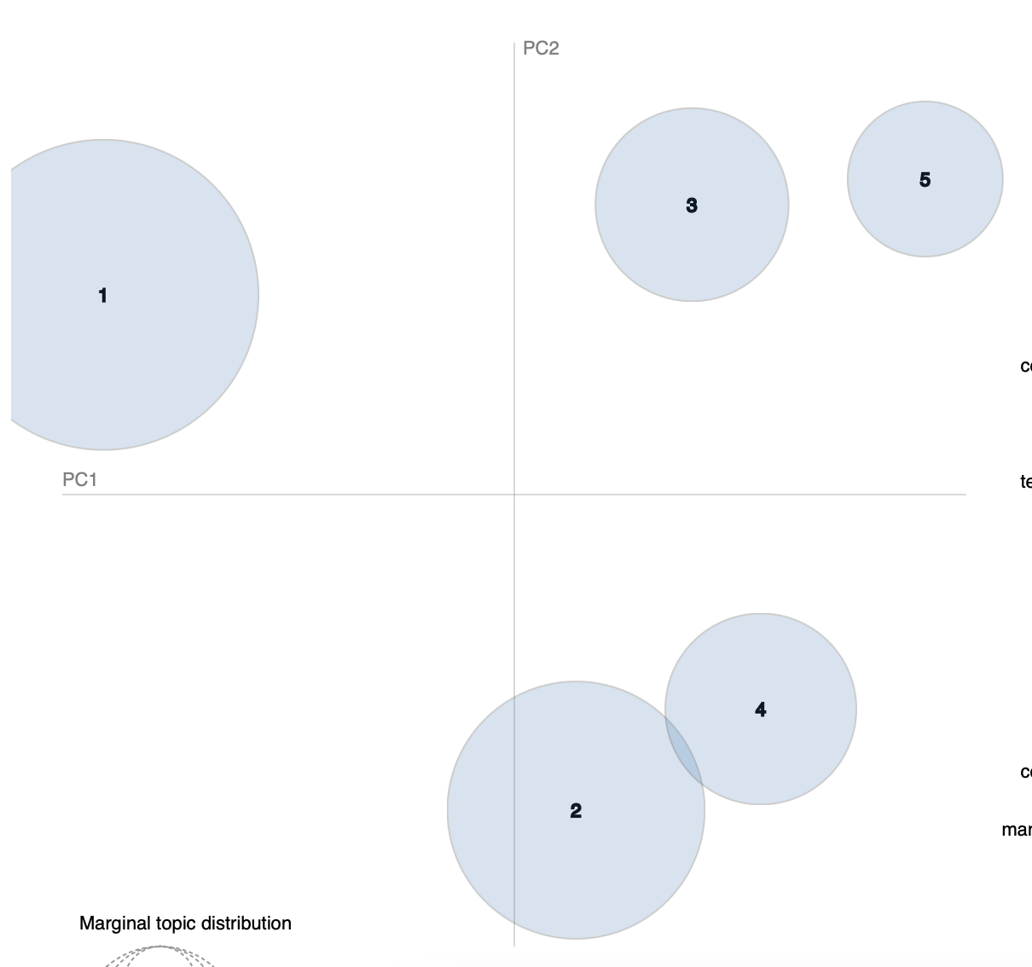
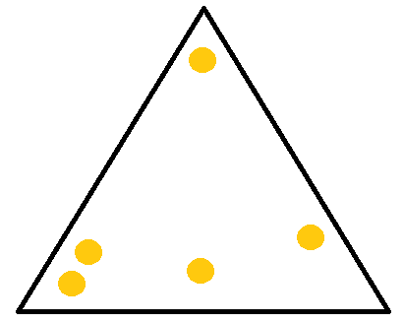
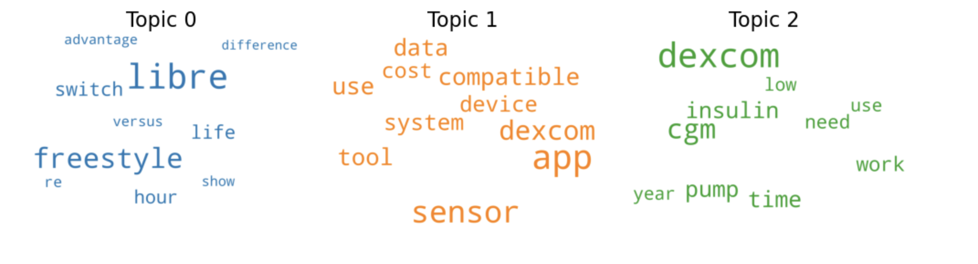
1
2
3
4
Pre-processing
Model
Identify dominant topic
Review and Label
Notes:
For achieving the this, we followed a four step process

Slide 14
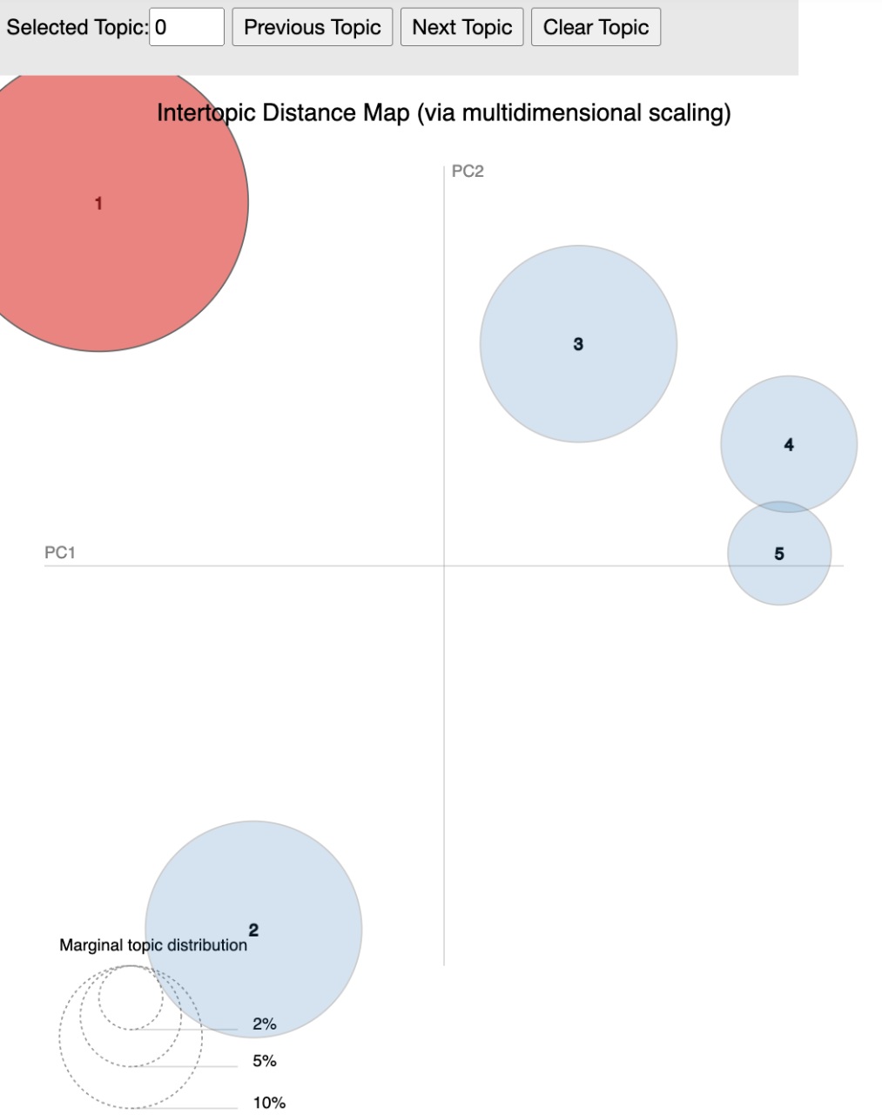
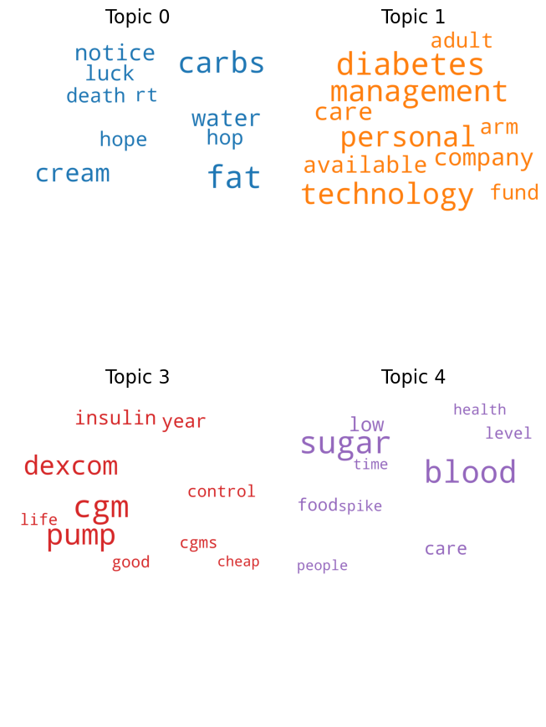
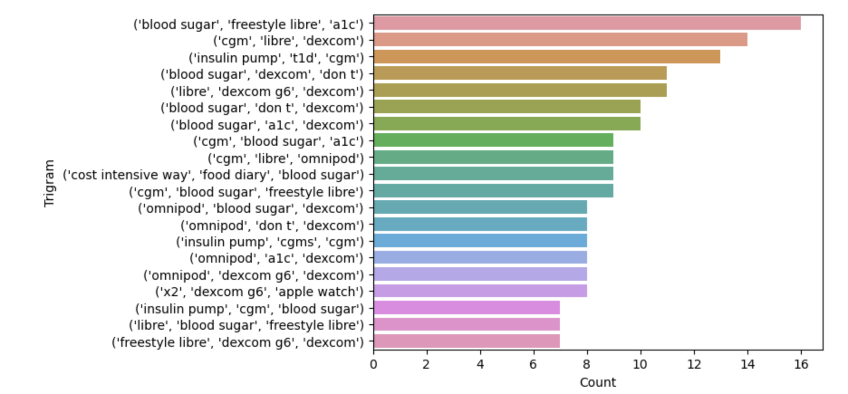
Visualizations
Intertopic Distance Map
Word Cloud
Bi-grams/Tri-grams
Notes:
based our decisions on these visualizations

Slide 15
Agenda
Background & Approach
Problem at Hand
Project Goal
Beneficiary from Solution
Exploratory Data Analysis
Data pre-processing
Data Modelling
Results & Evaluation
Recommendations

Slide 16
Result & Evaluation

Slide 17




General CGM Analysis

Slide 18
Patient Expectations
Longer Battery Life
Prompts for Emergencies
Wear-Friendly
'I've learned to have extra batteries for the glucometer, learned the hard way, when my CGM died. I buy them in bulk- 10, for what one name brand battery would cost, and the lithium CR-2032 is used in a lot of electronics devices.'
'I'm hypoglycemia unaware. I don't sense/can't tell when my blood sugar is dangerously low. I require a CGM to tell me when that happens, especially so it doesn't happen in the middle of the night and I end up seizing or dying. CGMs are expensive. So basically, I'm already a cyborg and paying extra for the “privilege".'
I’m an insulin pump wearer so I always need pockets and non restrictive waistlines where my tubing set/CGM is placed!'

Slide 19
Knowledge Gaps
General Usage
Efficacy and Accuracy
Next steps?
'Can I put my CGM on my thigh? I know we are told not to yet but if anyone has broke that rule are there any real consequences?'
'Using insulin or oral meds? A pump? I’m especially curious about pump/CGMs because I’ve been managing with 3 different insulins (bolus Novolog w/a sliding scale & Lantus as my basal plus NPH to specifically manage my semi-elemental formula) and just a meter but as my pancreas gets worse my diabetic control does too and the meter/CGM folks seem to have better control. Is that accurate?
even if she could get a CGM she wouldn't use it. What would she do with the information? After all, she won't change her diet.'
Yes! Regardless, I still see thousands of Type 1 diabetics that still do not understand their diagnosis, insulin, and CGM trends. We have a bunch that do not know how to properly adjust basal rates, bolus times, and insulin pump sites.'
'Anyone have any tips about blood sugar control during a judo competition? I did a dry run with my CGM and found I couldn't directly rely on it and I generally ran low after each match.

Slide 20
Benefits to Diabetes Patients
Unobtrusive nature
Live Monitoring: Better Management
Figuring out lifestyle
I don’t have to prick my finger as much anymore, because I got this pump CGM (Continuous Glucose Monitor) it’s pretty much taken care of the whole pricking fingers, which is AWESOME.
My CGM makes a major difference for me in managing my diabetes.
the app has nice statistics that really correlate with glycated haemoglobin (HbA1c - long term sugar level indicator) results from my checkups. You can (and should) calibrate the CGM results with prick tests in the Glimp app as well. It takes a long time testing what kind of carbohydrates work the best for you - how high / how fast your blood sugar levels rise, and how long they stay high. You have to keep yourself as close to the ideal range as possible, while are literally trying out every available carb in the pantry.
I now have a cgm and insulin pump which helps take the pressure off a little bit once you know if you can trust the sensor. I would recommend talking to your doctor about that. I personally did not have a sip of alcohol until I got a cgm because of the worry of it all but that won't necessarily work for you. Just be smart and be careful! It's a trip trying to figure out how diabetes works and how all the different foods and life factors affect you as well.

Slide 21
Unmet Needs
Reliability
Ease of use
Cost & Coverage
today when I checked my libre 2 it told me my blood sugar was 14.9 ?? when in actual fact it was 7.8 (finger prick test). This evening it read 4.5 but I felt lower than that and yup 2.4!
'none of the tubes are even remotely long enough. I can order my sets with up to 48" long tubes. But yea I'm with you, I do legs for the insulin, stomach for the CGM.'
'I wanted to ask what has been your experience applying and getting coverage. I work at a temporary contractor and don't have drug insurance. I have been paying for my supplies, insulin and CGM (Libre) out of pocket and it's starting to become a bit too expensive.
. I would consider a CGM if my insurance covered it.

Slide 22
CGM Product-Specific Analysis

Slide 23
Dexcom
Praises
Complaints
Advance Warning
Battery Life
I love dexcom and Tslim IQ control. So it will warn me that in 15 I will be going low. I now try and eat 10 skittles and set my alarm for 15 minutes.
Integration with other devices
sigh the life of a diabetic. My Dexcom died when I was camping in the middle of the woods a few weeks ago. One of the rare times I didn't have a backup. Scary.
Failing Sensors
Recently I've been getting a lot of sensor failures. I think it might be caused by taking hot baths at 40C. I'm not sure if it is a coincidence or not. Has anyone had a similar experience?!
I have the newest Apple Watch and the Dexcom G6, and I have no complaints so far! I set the watch face to show my Dexcom reading so that I don't have to search for the app every time I want to check my sugar.
Customer Service
Inaccurate Readings
I absolutely love my Dexcom, but I’ve definitely had sensors malfunction. The good news is that their customer is great and they always send replacement sensors.
In my experience, Dexcom readings in the first 24 hours are a little inaccurate. I usually calibrate it once and let it work itself out. If I continue to get inaccurate numbers after 24 hours or if the discrepancy is over 50-60 points, I call Dexcom to get a replacement

Slide 24
FreeStyle
Praises
Complaints
Convenience
Obtrusive
This device has been a lifesaver for me. The convenience and accuracy of the Freestyle Libre have made managing my diabetes much less stressful and time-consuming.
Accuracy
I dread inserting the Freestyle Libre sensor because it's so painful. Sometimes it feels like I'm being stabbed with a needle. And even after the sensor is removed, I'm left with a dark mark on my skin for days.
Failing Sensors
I've had several sensors fail within a few days of starting them, which is a waste of money.
I've found the Freestyle Libre to be highly accurate and reliable. It gives me peace of mind knowing that I can trust the readings I'm getting.
Real-time gathering
Expensive
The Freestyle Libre has made my life so much easier. With the ability to scan my sensor and receive real-time glucose readings, I feel much more in control of my diabetes management.
The cost of the sensors is so high that it's difficult to afford them on a regular basis given that they keep failing.

Slide 25
Product Features
Dexcom
FreeStyle
Dexcom Sensors
Compatibility with Insulin Pumps
Data Sharing
No fingersticks
Trend arrows
Water Resistance
Data Storage
App Compatibility
Topics
Diabetes Management and affordability of devices
Blood sugar monitoring and management
CGM and Features
Product Functionality and Usability
Insurance costs

Slide 26
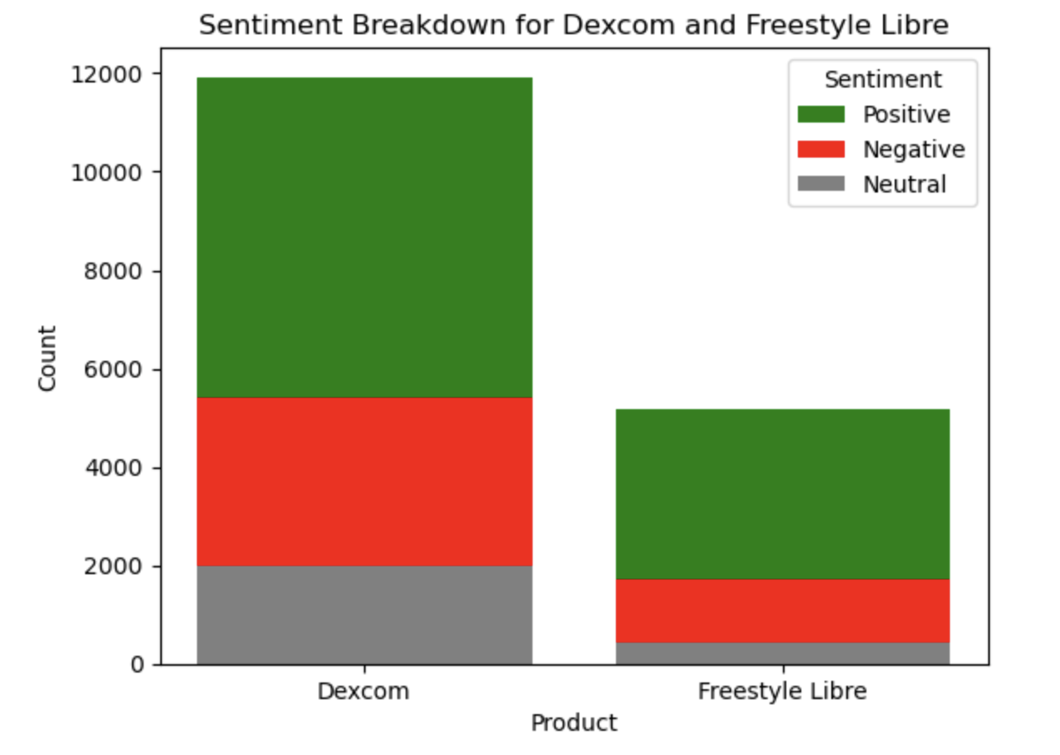
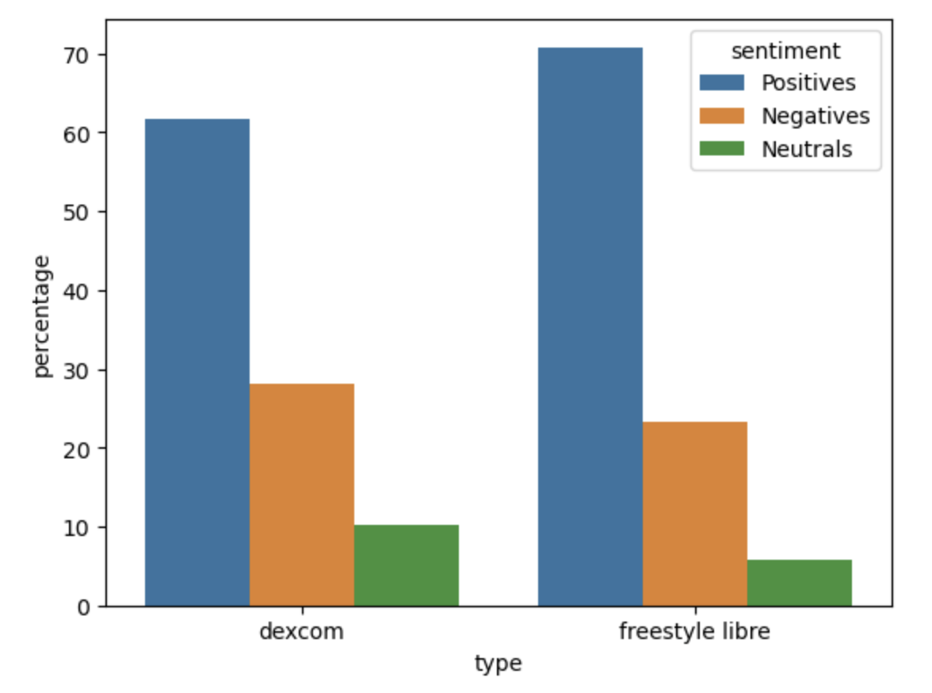
Dexcom vs. Freestyle Opinions

Slide 27
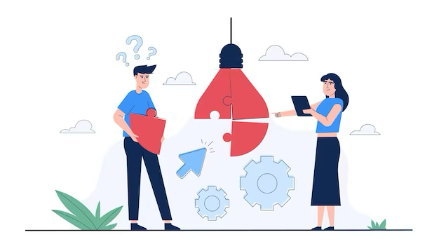
Recommendations

Slide 28
Recommendations
Overall
Customers expect high accuracy and real-time updates to BG levels
Educate users on how to use, operate, and replace sensors
Work with insurance providers to smoothen approval process & make it affordable
Dexcom
Freestyle Libre
Add snooze button after alarm if blood glucose goes off
Ensure timely customer service and experience
Reduce calibration time, on par with Dexcom
Improve reading accuracy as there are discrepancies currently

Slide 29
Thank You!
Questions?

